Slide 1

NUMBER GUESSING GAME
T.shivajyothi 2103A51148
B.SrujanaReddy 2103A51221
R.Deepthi 2103A51336

Slide 2
CONTENTS:
Introduction
Objectives
Elements used in this project
Result Screens
Conclusion

Slide 3
INTRODUCTION:
The Number Guessing Game Java application represents a modern take on the classic arcade experience, blending nostalgia with contemporary programming techniques.
This project showcases the versatility and robust capabilities of Java in creating an engaging and interactive gaming environment.
The game's core mechanics centers about the guessing of game thinking various possibilties and various situations thinking capacity.
To enhance user engagement, the Number Guessing Game incorporates a scoring system, and the time capability of the user.

Slide 4
OBJECTIVE:
We are introducing choosing difficulty level to give the user challenging game. In a number guessing game using a GUI in Java, the main objectives are to create an enjoyable and interactive gaming experience for the player.
Create a visually appealing and user-friendly GUI that encourages player engagement. Use buttons, text fields, labels, and other graphical components to make the game easy to understand and play.
Generate a random number within a specified range that the player needs to guess. This adds an element of unpredictability to the game. Allow the player to input their guesses using the GUI, typically through a text field and a submit button. Provide immediate feedback to the player regarding whether their guess is too high or too low in comparison to the target number.
This feedback keeps the player engaged and motivated. Implement the core game logic that tracks the number of attempts, checks for the correct guess, and enforces any game-over conditions (such as running out of attempts).

Slide 5
ELEMENTS USED IN THE PROJECT:
User Interface (UI) : The game features a user-friendly interface that allows players to input their guesses, view feedback, and navigate through the game's screens.
Random Number Generation: The game generates a random number within a specified range, which the player must guess correctly.
Feedback Mechanism: After each guess, the game provides feedback to the player, indicating whether the guess is too high or too low, helping them refine subsequent guesses.
Guess Input Mechanism: Players can enter their guesses through an input mechanism, such as a text box or buttons.
javax.swing.*: This statement imports all the classes in the javax.swing package, which is a part of the Java Standard Library. It includes classes for creating graphical user interfaces (GUIs)
.

Slide 6
Winning Condition :The game defines the criteria for winning, typically when the player guesses the correct number within a set number of attempts.
Number Range : Players are given a range (e.g., 1-100) within which the hidden number exists. This range can be customizable for different difficulty levels.
Attempt Limit: The game may limit the number of attempts or guesses a player can make, adding a level of challenge.
Score or Timer : Some games incorporate a scoring system or timer to track the player's performance and competitiveness.
java.awt.*: Similar to the previous statement, this imports all the classes in the java.awt package, which contains classes and methods for basic GUI components and layouts.

Slide 7
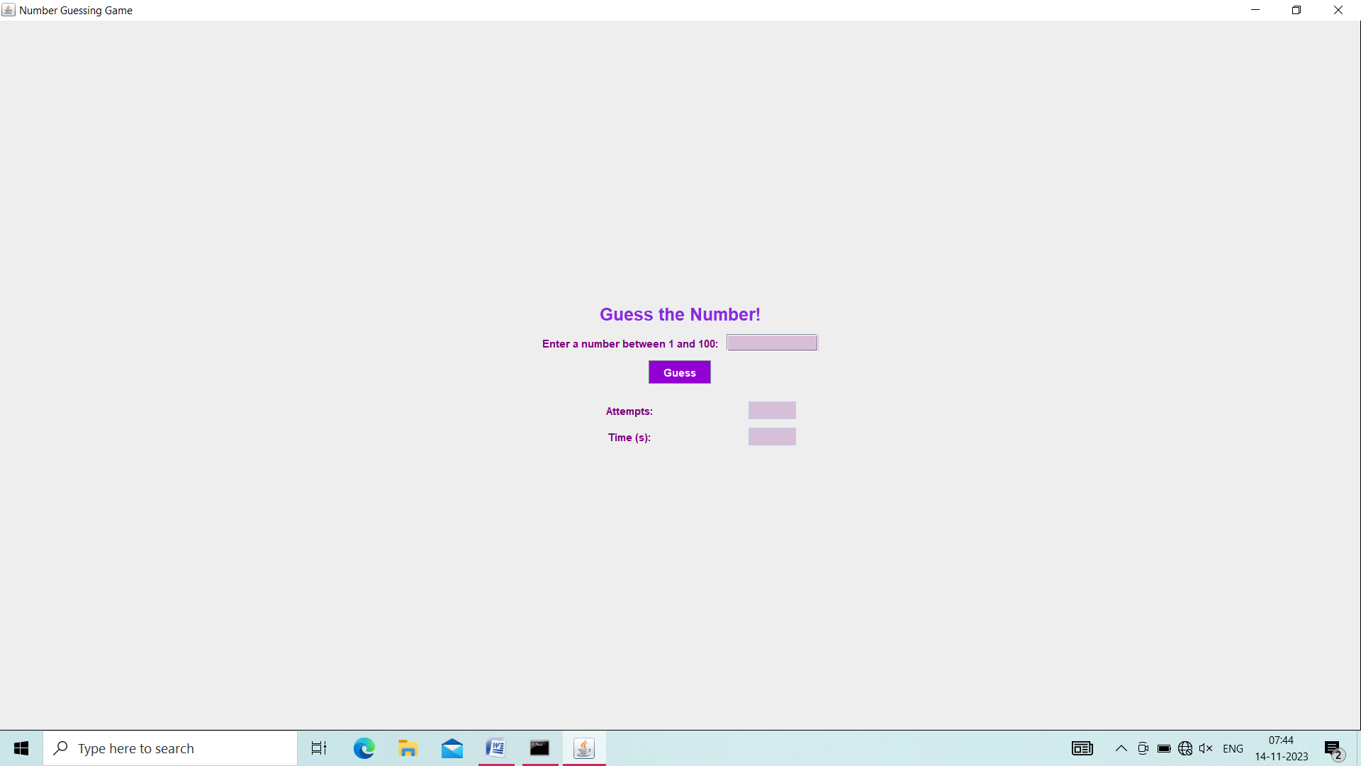
SCREENS:

Slide 8


Slide 9


Slide 10


Slide 11


Slide 12
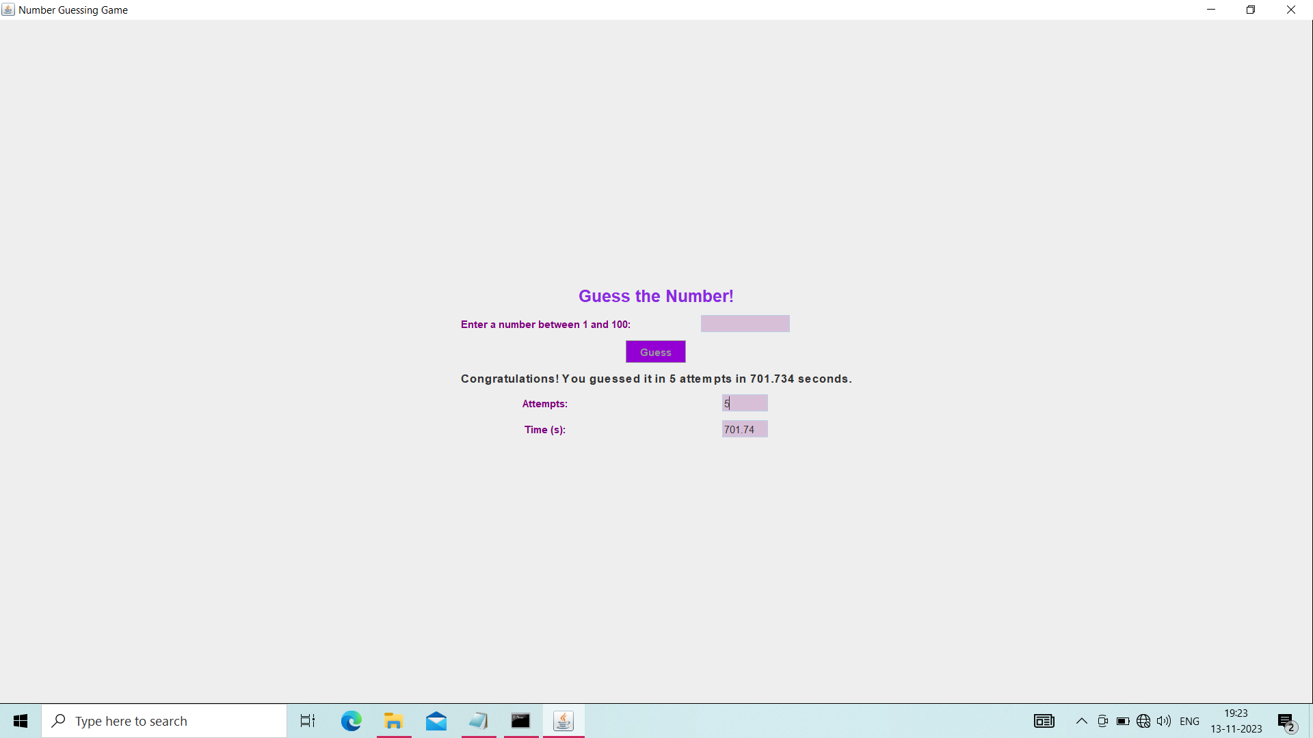

Slide 13
CONCLUSION:
Building a number guessing game with a GUI is an excellent way for beginners to learn both Java programming and GUI development. It involves concepts like event handling, components, and layout design. Players can interact with the game using buttons, text fields, and other graphical elements. The game's potential can make guess how one’s mind works fast to improve the no.of situations that can be possible at a 21 time a it can improve the guessing speed of an situation and we can think quick ways to analyse the situation. In conclusion, while the current implementation offers a basic but functional number guessing game, there's room for expansion and improvement to make the gameplay more diverse, challenging, and visually appealing for a broader audience.

